Slide 1
AIC Database project
Kinori Rosnow, Tejasvi Medi, Tula Sah, Shubhrika Sehgal

Slide 2
What is it?
Weekend school system
Runs for 35-40 school days per year
Handles administration tasks
Teacher
assign task
track whether the task is completed or not
manage assigned classroom
Parent
communicate with teachers/administration
monitor their children’s progress
Student
Check assigned task and complete them

Slide 3
Resources
Laravel Framework
Follows MVC architectural pattern
Front –end
HTML, CSS, JavaScript, Bootstrap
Back-end
Php

Slide 4
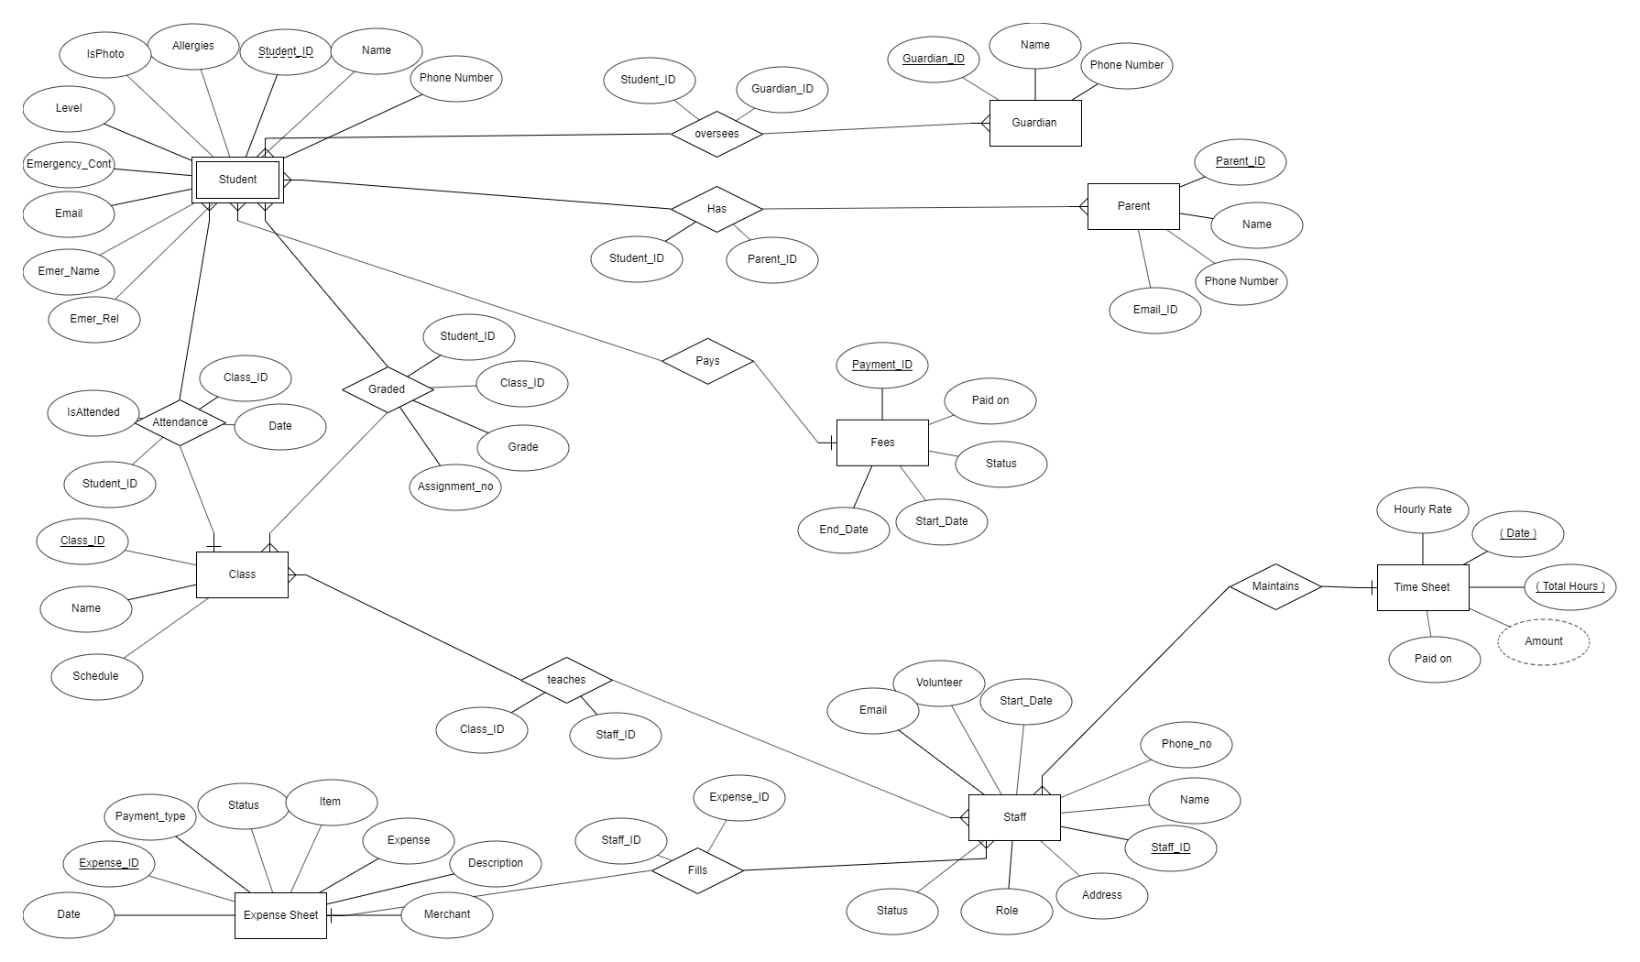
Database Diagram

Slide 5
project Demo

